Slide 1
Minimizing Dockerfiles
Report 2 – 10th of May 2025
Andrei Petrea
scpetrea@gmail.com
Prof. Răzvan Deaconescu

Slide 2
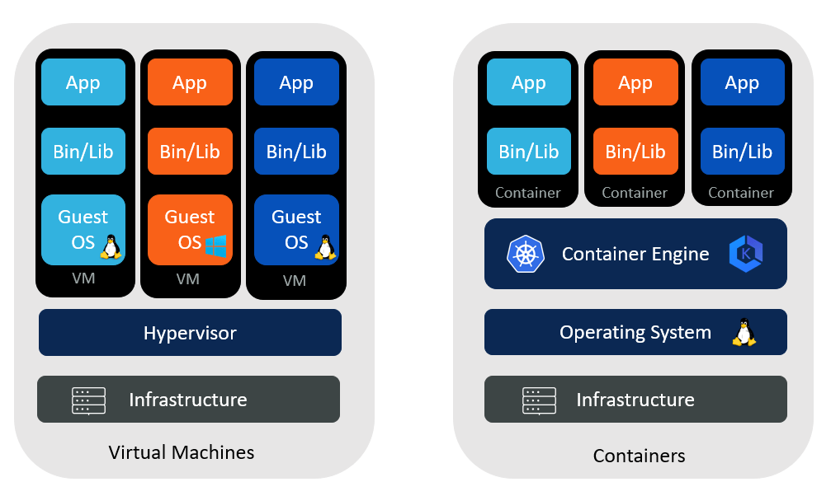
Introduction
Virtualization: The simulation of the software and/or hardware upon which other software runs.
Containerization: A method for packaging and securely running an application within an application virtualization environment (container)
VMs vs Containers ^{[1]}
2
Notes:
[1] Comparing VMs and Containers - Aqueduct Tech

Slide 3
Dockerfile
FROM python:3.12
WORKDIR /usr/local/app
COPY requirements.txt ./
RUN pip install --no-cache-dir \
-r requirements.txt
COPY src ./src
EXPOSE 5000
RUN useradd app
USER app
CMD ["uvicorn", "app.main:app", "--host",
"0.0.0.0", "--port", "8080"]
Base image
Adding files to the container + metadata
Command to be run
3
Notes:
[1] Comparing VMs and Containers - Aqueduct Tech

Slide 4
Context
1. Problem
2. Industry solution
3. Building from scratch
• image size: 1.02 GB • based on a full Debian distro

Slide 5


Context
1. Problem
2. Industry solution
3. Building from scratch
• Slim Debian^{[2]}, Alpine Linux^{[3]}
• equivalent image for python, node,
java, etc
Notes:
[2] debian - Official Image | Docker Hub [3] alpine - Official Image | Docker Hub

Slide 6
Context
1. Problem
2. Industry solution
3. Building from scratch^{[4]}
Docker’s minimal image (no files)
each dependency has to be manually added
used mostly in multi-stage builds
Notes:
[4] scratch - Official Image | Docker Hub

Slide 7
Motivation
1. Efficient use of resources
2. Reduction of costs
3. Faster boot-time

Slide 8

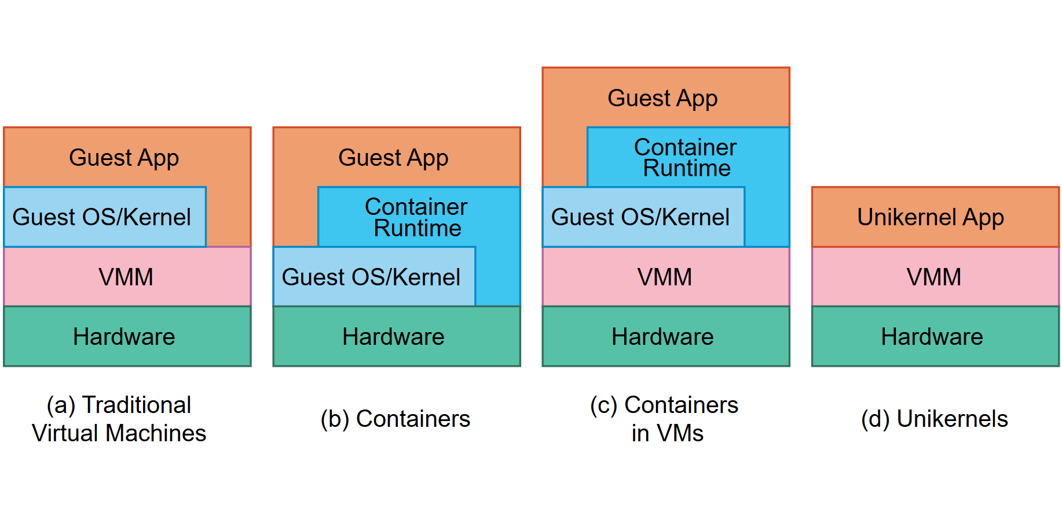
Use Case
High-level comparison of the software components of traditional VMs (a), containers (b), containers in VMs (c) with unikernels (d)^{[5]}
Notes:
[5] Concepts - Unikraft

Slide 9
Use Case
spec: v0.6
runtime: base:latest
rootfs: ./Dockerfile
cmd: ["/helloworld"]
minimal Dockerfile
Kraftfile for hello-world in C^{[5]}
Notes:
[5] catalog/examples/helloworld-c/Kraftfile at main · unikraft/catalog

Slide 10
How?
Determine the dependencies of the command
• Using ldd
linux-vdso.so.1 (0x00007ffd68d5f000)
libc.so.6 => /lib/x86_64-linux-gnu/libc.so.6 (0x00007f23ba6b0000)
libpthread.so.0 => /lib/x86_64-linux-gnu/libpthread.so.0 (0x00007f23ba68d000)
libdl.so.2 => /lib/x86_64-linux-gnu/libdl.so.2 (0x00007f23ba687000)
libutil.so.1 => /lib/x86_64-linux-gnu/libutil.so.1 (0x00007f23ba682000)
libm.so.6 => /lib/x86_64-linux-gnu/libm.so.6 (0x00007f23ba533000)
libexpat.so.1 => /lib/x86_64-linux-gnu/libexpat.so.1 (0x00007f23ba505000)
libz.so.1 => /lib/x86_64-linux-gnu/libz.so.1 (0x00007f23ba4e7000)
/lib64/ld-linux-x86-64.so.2 (0x00007f23ba8b5000)
ldd python3

Slide 11
How?
Determine the dependencies of the command
• Using ldd
• Using strace
open, exec
follow child processses
strace -fe execve,openat,open ls
execve("/usr/bin/ls", ["ls"], 0x7ffee0a0a390 /* 36 vars */) = 0
openat(AT_FDCWD, "/etc/ld.so.cache", O_RDONLY|O_CLOEXEC) = 3
openat(AT_FDCWD, "/lib/x86_64-linux-gnu/libselinux.so.1", O_RDONLY|O_CLOEXEC) = 3
openat(AT_FDCWD, "/lib/x86_64-linux-gnu/libc.so.6", O_RDONLY|O_CLOEXEC) = 3
openat(AT_FDCWD, "/lib/x86_64-linux-gnu/libpcre2-8.so.0", O_RDONLY|O_CLOEXEC) = 3
openat(AT_FDCWD, "/lib/x86_64-linux-gnu/libdl.so.2", O_RDONLY|O_CLOEXEC) = 3
openat(AT_FDCWD, "/lib/x86_64-linux-gnu/libpthread.so.0", O_RDONLY|O_CLOEXEC) = 3
openat(AT_FDCWD, "/proc/filesystems", O_RDONLY|O_CLOEXEC) = 3
openat(AT_FDCWD, "/usr/lib/locale/locale-archive", O_RDONLY|O_CLOEXEC) = 3
openat(AT_FDCWD, "/usr/share/locale/locale.alias", O_RDONLY|O_CLOEXEC) = 3

Slide 12
How?
Determine the dependencies of the command
• Using ldd
• Using strace • Trial and error
Adding and removing files until the command works

Slide 13

Implementation
High-level language with low-level support
Thriving ecosystem of modules and libraries
Directly interact with Docker (Docker SDK^{[6]})
Notes:
[6] client package - github.com/docker/docker/client - Go Packages

Slide 14
Flow
app.post("/", (req, res) => {
const url = req.body.url;
if (!url) {
return res.status(400).json({ error: "URL is required" });
}
if (!/^https?:\/\/.+/.test(url)) {
return res.status(400).json({ error: "Invalid URL format" });
}
if([...urls.values()].includes(url)) {
return res.json({ shortUrl: [...urls.entries()].find(([key, value]) => value === url)[0] });
}
while (true) {
const shortUrl = generateShortURL(6);
if (!urls.has(shortUrl)) {
urls.set(shortUrl, url);
return res.json({ shortUrl });
}
}
}); app.get("/:shortUrl", (req, res) => {
if (urls.has(req.params.shortUrl)) {
res.redirect(urls.get(req.params.shortUrl));
}
else {
res.status(404).json({ error: "URL not found" });
}
}); app.listen(port, hostname, () => {
console.log(`Server is running at http://${hostname}:${port}`);
});
URL shortener app

Slide 15
Flow
FROM node:20.9.0
WORKDIR /app
COPY app.js /app/app.js
COPY package.json /app/package.json
COPY package-lock.json /app/package-lock.json
RUN npm install
EXPOSE 3000
CMD ["node", "app.js"]
Dockerfile for our application
Image size: 1.1 GB

Slide 16
Flow
Preprocessing
Validating Dockerfile
content, _ := os.ReadFile(dockerfile)
_, err := parser.Parse(strings.NewReader(string(content)))
if err != nil {
os.RemoveAll(envPath)
panic("Failed to parse Dockerfile: " + err.Error())
}

Slide 17
Flow
Preprocessing
Validating Dockerfile
Creating environment + extracting filesystem
/home/belea/.dockerminimizer/95cf618ae8b8efa8f01d7186494892b6/rootfs
├── app
├── bin -> usr/bin
├── boot
├── dev
├── etc
├── home
├── lib -> usr/lib
├── lib32 -> usr/lib32
├── lib64 -> usr/lib64
├── libx32 -> usr/libx32
├── media
├── mnt
├── opt
├── proc
├── root
├── run
├── sbin -> usr/sbin
├── srv
├── sys
├── tmp
├── usr
└── var

Slide 18
Preprocessing
Validating Dockerfile
Creating environment + extracting filesystem
Generating a template Dockerfile
Environment Variables
- PATH=/usr/local/sbin:/usr/local/bin:/usr/sbin:/usr/bin:/sbin:/bin
- NODE_VERSION=20.9.0
- YARN_VERSION=1.22.19
Working directory: /app
Ports : 3000/tcp
Entrypoint : ["docker-entrypoint.sh"]
Command: ["node", "app.js"]

Slide 19
Static Analysis
Full command: docker-entrypoint.sh node app.js
Base command: docker-entrypoint.sh
Running ldd docker.entrypoint.sh
Fails because a .sh file is not linked
Skips static analysis, continues with dynamic analysis

Slide 20
Dynamic Analysis
Full command: docker-entrypoint.sh node app.js
Mounting a statically-linked strace to the container
Trace open,openat,execve,execveat syscalls
regex :
syscall + `\([^"]*?"([^"]+)"`
Check for a shebang
shebang found: /bin/sh
rerun static analysis + dynamic analysis for /bin/sh
Build new Dockerfile and validate it
analysis successful

Slide 21
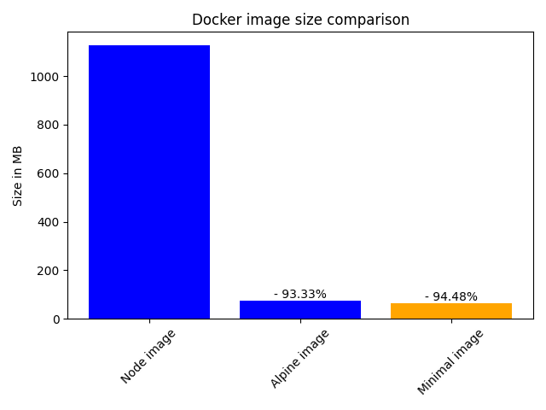
Flow
minimal Dockerfile
105 build stages
62.3 MB

Slide 22
Status and Future Work
ROADMAP
Mid – Late May
Late May- early June
Mid June
Mid – Late June
28th of June
June
Fix issues with dynamic analysis
Implement binary search
Fix all issues with the app
Refactor the code
Finish the project

Slide 23
THANK YOU
FOR YOUR ATTENTION!
😊

